Slide 1
Heroku Partner
Heroku Quick Start Playbook
Tom Cullen
tom@launchpadlab.com
http://launchpadlab.com

Slide 2
Who is LaunchPad Lab?
Our mission is to build the very best web and mobile
applications to help grow businesses.
About us
A full service web and mobile team:
Never compromise on quality
Deliver value fast
Constant client collaboration
Our Expertise
User experience design
User interface design
Visual design / Branding
Mobile development
Front end programming
Back end programming
Business consulting
14
5
Amazing team members
Years making
awesome products

Slide 3
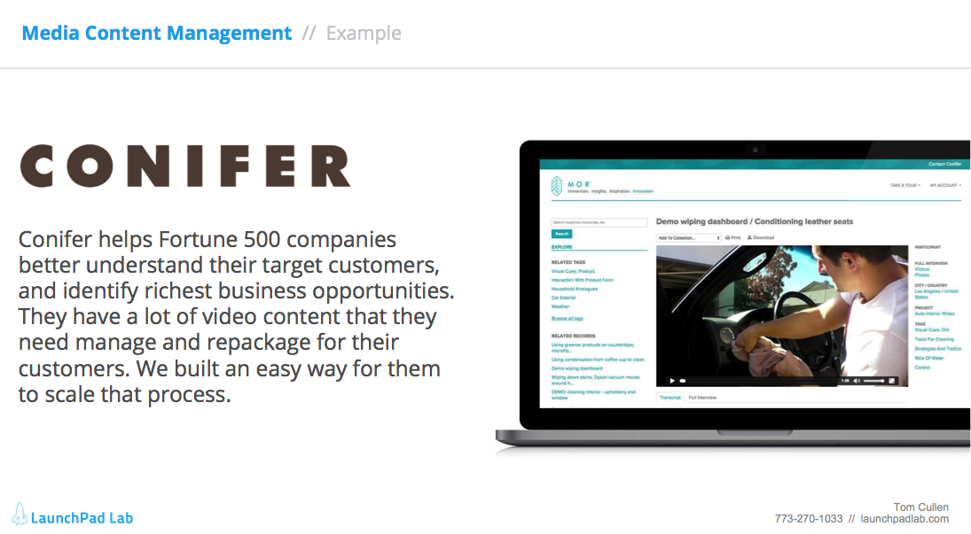
How to use this playbook
Each Quick Start Package has 2 pages
1
Package Details
Understand a use case with potential features. Budget and timeline guidelines
2
Example
Learn about a project we built with similar features and functionality

Slide 4
Interactive quiz game
Core Features
Quiz functionality
Moderator guided ability
Leaderboard
Time based scoring algorithm
Custom designed for your brand
Mobile ready
Engage your audience by gamifying your content. Create an exciting quiz game to interact with your team or customers. Customize the experience to your brand and give people something to talk about long after they use it.

Slide 5
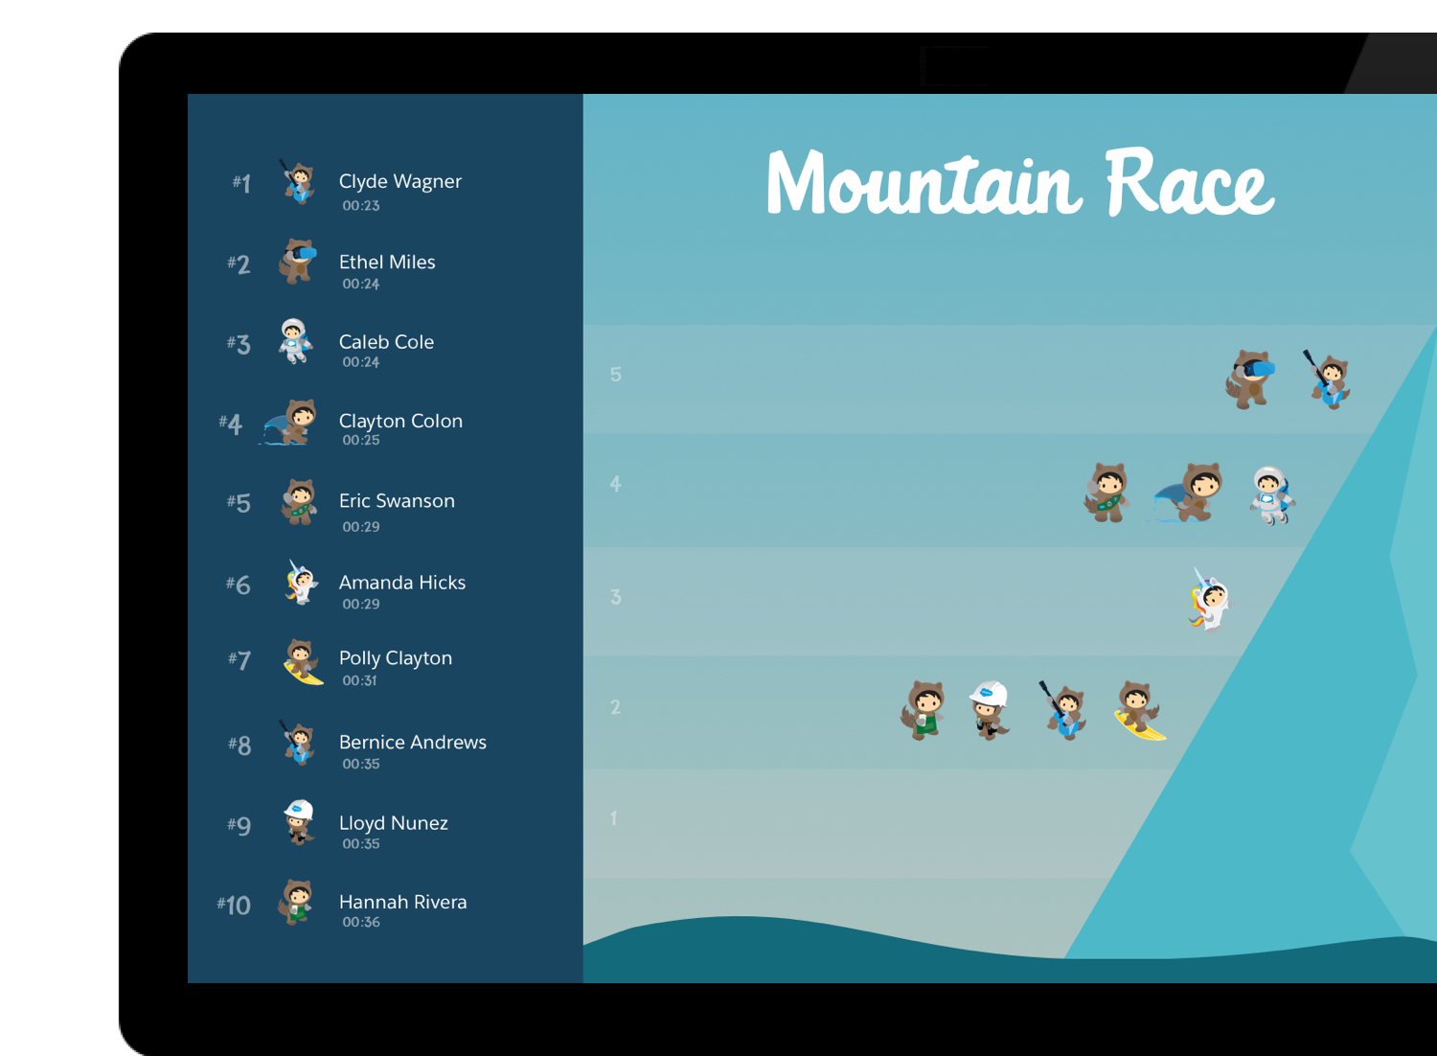
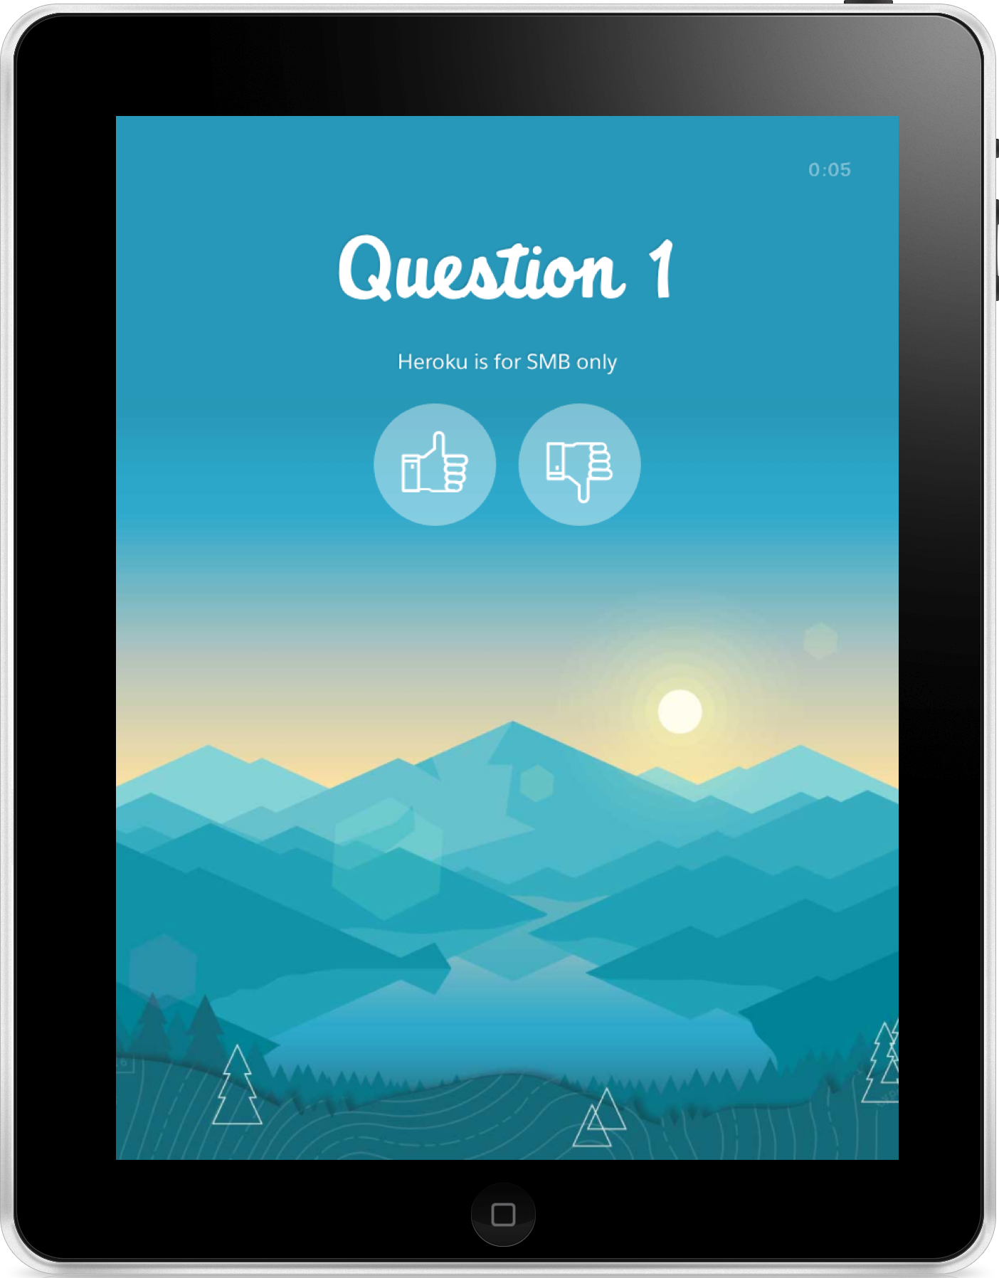
Interactive Quiz Game // Example
Salesforce’s enablement team asked us to help them create a way to better engage their teams during their Sales Kick Off sessions. We worked with their creative team to build a mountain climber app that showed the winner based on number of questions correct and amount of time it took to answer. The start of the game was controlled by an MC and all participants could see where they were on the leaderboard.

Slide 6
Media Content Management
Core Features
• Video Management
• Share insights across departments
• Dynamic Search
• Flexible Presentation
• Custom Designed for your business
Organize your digital media. Uncover themes and connections found in videos and photos. Transcribe, tag, and make available to you and your team for easy collaboration.

Slide 7
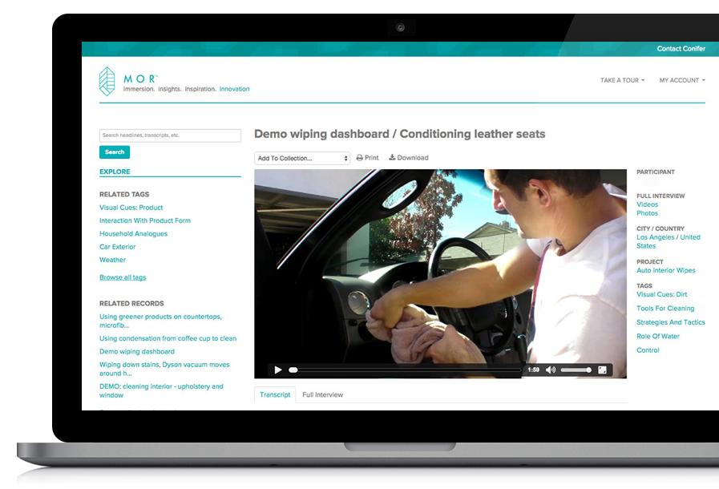
Media Content Management // Example
Conifer is a market research firm who helps Fortune 500 companies better understand their target customers, and identify promising business opportunities. We built an easy way for them to scale their data and media storage. This gives Conifer the ability to handle more client projects, share market insights, and help those clients make informed product development decisions.
View Site

Slide 8
Document/ Knowledge sharing platform
Core Features
Document Version Control
Dynamic Search
Permissions Management
Commenting
Push notifications to keep users informed
Organize and collaborate on your documents. Easily find your important documents and see their history. Comment, share, and collaborate on them.

Slide 9
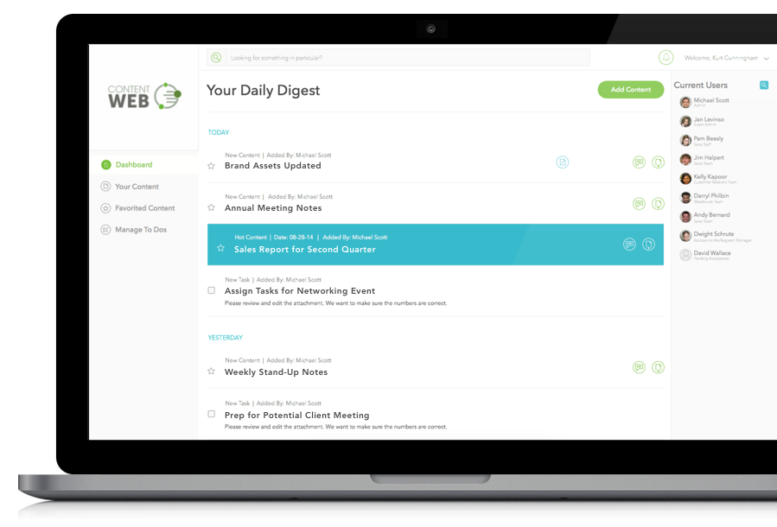
Document/Knowledge sharing platform // Example
ContentWeb helps PR groups be much more effective. We worked with them to create a way to easiliy organize, categorize, and access their communications content. Now they can quickly share documents, save new versions, collaborate and comment on them on any device.
View Site

Slide 10
E-commerce Platform
Core Features
Custom Design / User Experience
Detailed Product pages
Inventory management
Payment processing
Shipping integration
Create a robust online store with the flexibility to add features to ramp up your sales. A rock solid e-commerce foundation including inventory management, shopping cart, and quick checkout experience.

Slide 11
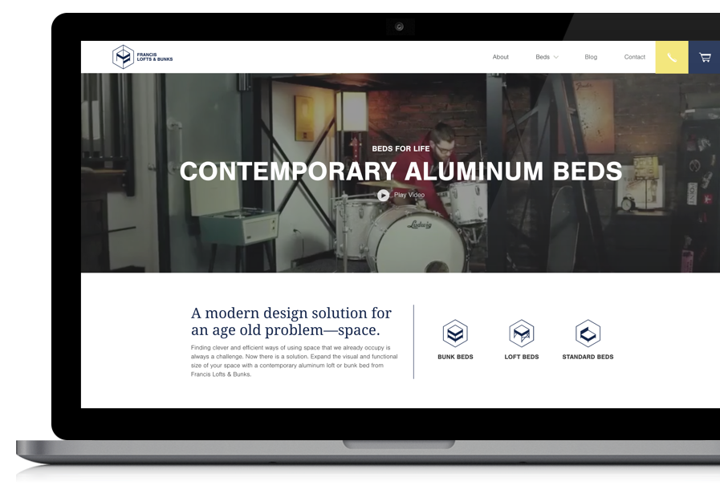
E-commerce Platform // Example
Francis Lofts and bunks builds king and queen size loft and bunk beds. Their entire presence is online through their e-commerce store. We built a store that is focused on using design and user experience to drive sales higher. Our close attention to SEO and page load speed optimization really helped drive growth by 300%.
View Site

Slide 12
IoT Device Platform
Core Features
Integration with device
TCP/IP/Socket connection for real-time data access
Cloud based API
Cloud data and asset storage
User interface to visualize device data
Connect your smart device to the cloud. A robust integration will give you the power to truly leverage data from the device. We connect devices to the cloud and build custom software that will give you actionable insights into your data.

Slide 13
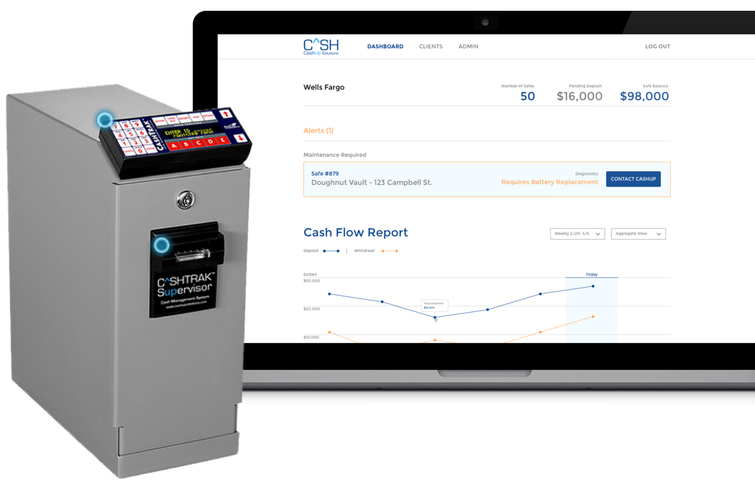
IoT Device Platform // Example
CashUp helps store owners manage their cash. They have physical safes that are connected to the cloud so business owners and their banks have real time access to how much money is in the safe. We built the software infrastructure for connecting the safe to the cloud as well as the applications for the business owners and the banks.
View Site

Slide 14
Ticketing/Reservation System
Core Features
Custom Design / User Experience
Detailed Event/Product pages
Integration with ticketing platform
Custom ticket checkout flow
Payment processing
Custom integration with your preferred ticketing and reservation system. We design and develop fully integrated ways to sell tickets on the web, mobile devices, and in person.

Slide 15
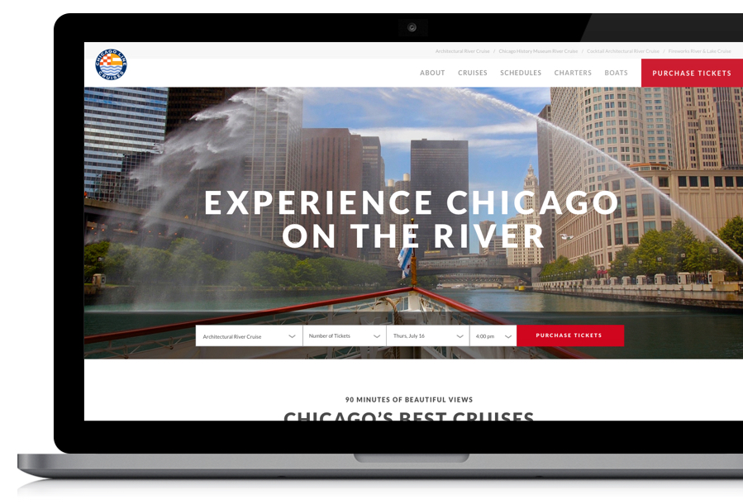
Ticketing/Reservation System // Example
Chicago Line is the most elite cruise line that runs historical and architecture tours along Chicago’s waterfront and river. We built them a new website to match their brand and create a very successful user experience. We focus on converting visitors into customers as well as SEO to help their business really grow.
View Site

Slide 16
CMS - Content Management System
Core Features
3-5 page templates
Admin backend
Multi-site support
Responsive design
SEO
Easily add, update, and manage the content on your website. Optimize your website for all devices. API opens your content to other applications/outlets.

Slide 17
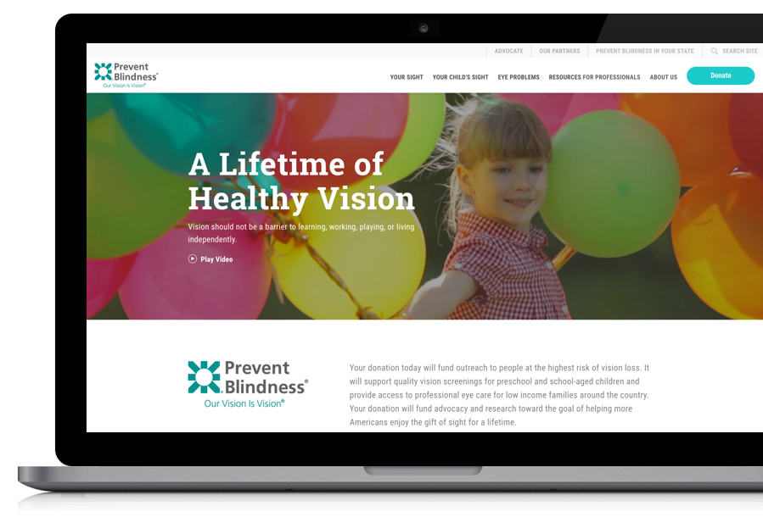
CMS - Content Management System // Example
Prevent Blindness is a national non profit that is the place to find information about eye diseases. With chapters in almost every state, Prevent Blindness needed a content management system that would allow them to manage content on a national and statewide level. We worked with them to design an application that helps them continue their presence as the leader in eye disease prevention.
View Site

Slide 18
Consumer IoT
Core Features
Integration with device
Custom Mobile apps
Cloud based API
Cloud data and asset storage
Data integration to Salesforce (Heroku Connect)
Connect consumer smart devices to a custom mobile app. The mobile experience connects to a web application via a custom API. We feed data to Salesforce to give you the power to know your customers. With this power you can show them a better experience, manage your business, and increase sales.

Slide 19
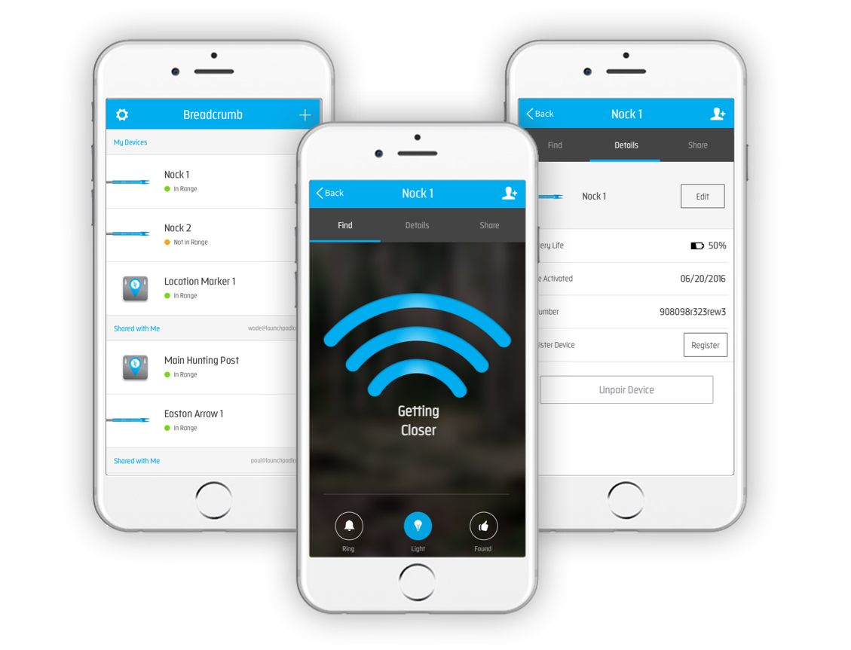
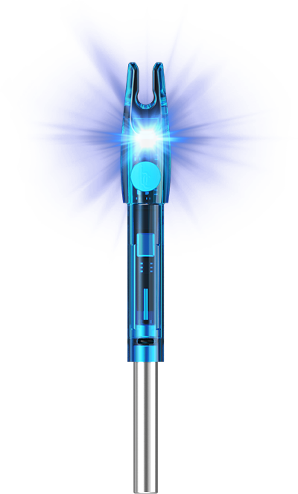
Consumer IoT // Example
Breadcrumb makes trackable technology for hunters. They have a Location Marker to help hunters find a bag or tree stand and a Nock that goes in an arrow to find your arrows after you shoot. We built the mobile apps to connect to the devices and the web application that feeds customer data back to Salesforce.
View Site

Slide 20
Certified Heroku Partner
Call us, and we will help scope your project.
Questions? Reach out to Tom Cullen
tom@launchpadlab.com
773-680-8987
http://launchpadlab.com

